Slide 1
Knowledge Representation
CME2002 Data Organization Management
Assoc.Prof.Dr.Adil ALPKOÇAK

Slide 2
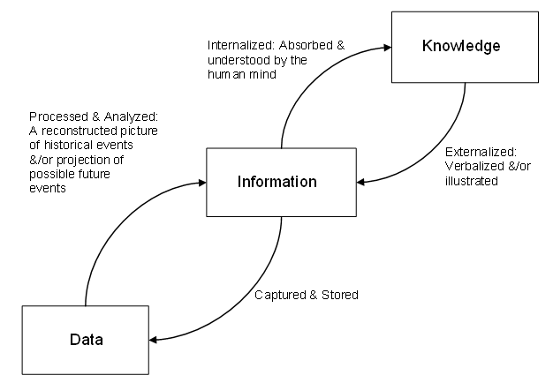
DIK

Slide 3
Knowledge
Knowledge is the understanding of rules needed to interpret information
“…the capability of understanding the relationship between pieces of information and what to actually do with the information”
Debbie Jones – www.teach-ict.com

Slide 4
Summary
Information
=
Data
+
Context
+
Meaning
Processing
Data – raw facts and figures
Information – data that has been processed (in a context) to give it meaning
Knowledge
=
Information
+
Rules

Slide 5
Knowledge Representation
What to Represent?
Let us first consider what kinds of knowledge might need to be represented in AI systems:
Objects
Facts about objects in our world domain. e.g. Guitars have strings, trumpets are brass instruments.
Events
Actions that occur in our world. e.g. Steve Vai played the guitar in Frank Zappa's Band.

Slide 6
Performance
A behavior like playing the guitar involves knowledge about how to do things.
Meta-knowledge
knowledge about what we know.

Slide 7
Thus in solving problems in AI we must represent knowledge and there are two entities to deal with:
Facts
-- truths about the real world and what we represent. This can be regarded as the knowledge level
Representation of the facts
which we manipulate. This can be regarded as the symbol level since we usually define the representation in terms of symbols that can be manipulated by programs.

Slide 8
We can structure these entities at two levels
the knowledge level
at which facts are described
the symbol level
at which representations of objects are defined in terms of symbols that can be manipulated in programs.

Slide 9
English or natural language is an obvious way of representing and handling facts.
Logic enables us to consider the following fact:
spot is a dog as dog(spot) We could then infer that all dogs have tails with:
Vx : dog(x)→ hasatail(x) We can then deduce:
hasatail(Spot)

Slide 10
Using Knowledge (1)
We have briefly mentioned where knowledge is used in AI systems. Let us consider a little further to what applications and how knowledge may be used.
Learning -- acquiring knowledge. This is more than simply adding new facts to a knowledge base.
New data may have to be classified prior to storage for easy retrieval, etc.
Duplication should be avoided.
Reasoning -- Infer facts from existing data.

Slide 11
Using Knowledge(2)
If a system only knows:
Davis is a Jazz Musician.
All Jazz Musicians can play their instruments well.
If things like Is Davis a Jazz Musician? or Can Jazz Musicians play their instruments well? are asked then the answer is readily obtained from the data structures and procedures.
However a question like Can Davis play his instrument well? requires reasoning.

Slide 12
Properties for Knowledge Representation Systems
The following properties should be possessed by a knowledge representation system.
Representational Adequacy
-- the ability to represent the required knowledge;
Inferential Adequacy
- the ability to manipulate the knowledge represented to produce new knowledge corresponding to that inferred from the original;
Inferential Efficiency
- the ability to direct the inferential mechanisms into the most productive directions by storing appropriate guides;
Acquisitional Efficiency
- the ability to acquire new knowledge using automatic methods wherever possible rather than reliance on human intervention.
To date no single system optimises all of the above !

Slide 13
Approaches to Knowledge Representation

Slide 14
Simple relational knowledge
The simplest way of storing facts is to use a relational method where each fact about a set of objects is set out systematically in columns. This representation gives little opportunity for inference, but it can be used as the knowledge basis for inference engines.
Simple way to store facts.
Each fact about a set of objects is set out systematically in columns.
Little opportunity for inference.
Knowledge basis for inference engines.

Slide 15
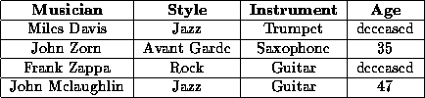
Figure: Simple Relational Knowledge

Slide 16
Inheritable knowledge
Relational knowledge is made up of objects consisting of
attributes
corresponding associated values.
We extend the base more by allowing inference mechanisms:
Property inheritance
elements inherit values from being members of a class.
data must be organized into a hierarchy of classes.

Slide 17
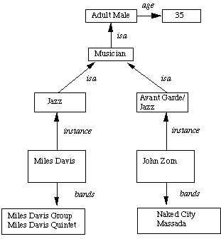
Boxed nodes -- objects and values of attributes of objects.
Values can be objects with attributes and so on.
Arrows -- point from object to its value.
This structure is known as a slot and filler structure, semantic network or a collection of frames.

Slide 18
Inferential Knowledge
Represent knowledge as formal logic:
All dogs have tails
V(X) : dog(x) → hasatail(x)
Advantages:
A set of strict rules.
Can be used to derive more facts.
Truths of new statements can be verified.
Guaranteed correctness.
Popular in AI systems. e.g Automated theorem proving

Slide 19
Procedural Knowledge
Basic idea:
Knowledge encoded in some procedures
small programs that know how to do specific things, how to proceed.

Slide 20
Advantages:
Heuristic or domain specific knowledge can be represented.
Extended logical inferences, such as default reasoning facilitated.
Side effects of actions may be modeled. Some rules may become false in time. Keeping track of this in large systems may be tricky.

Slide 21
What is Learning?
Learning is an important area in AI, perhaps more so than planning.
Problems are hard -- harder than planning.
A goal of AI is to enable computers that can be taught rather than programmed.
Learning is a an area of AI that focuses on processes of self-improvement.
Recognized Solutions are not as common as planning.

Slide 22
Why is it hard?
Intelligence implies that an organism or machine must be able to adapt to new situations.
It must be able to learn to do new things.
This requires knowledge acquisition, inference, updating/refinement of knowledge base, acquisition of heuristics, applying faster searches, etc.

Slide 23
How can we learn?
Many approaches have been taken to attempt to provide a machine with learning capabilities. This is because learning tasks cover a wide range of phenomena.
Listed below are a few examples of how one may learn.

Slide 24
Skill refinement -- one can learn by practicing, e.g playing the piano.
Knowledge acquisition -- one can learn by experience and by storing the experience in a knowledge base. One basic example of this type is rote learning.
Taking advice -- Similar to rote learning although the knowledge that is input may need to be transformed (or operationalised) in order to be used effectively.

Slide 25
Problem Solving -- if we solve a problem one may learn from this experience. The next time we see a similar problem we can solve it more efficiently. This does not usually involve gathering new knowledge but may involve reorganization of data or remembering how to achieve to solution.
Induction -- One can learn from examples.
Discovery -- Here one learns knowledge without the aid of a teacher.
Analogy -- If a system can recognize similarities in information already stored then it may be able to transfer some knowledge to improve to solution of the task in hand.

Slide 26
Rote Learning
Rote Learning is basically memorization.
Saving knowledge so it can be used again.
Retrieval is the only problem.
No repeated computation, inference or query is necessary.
A simple example of rote learning is caching
Store computed values (or large piece of data)
Recall this information when required by computation.
Significant time savings can be achieved.
Many AI programs (as well as more general ones) have used caching very effectively.
Memorization is a key necessity for learning:

Slide 27
Store v Compute
Rote Learning must not decrease the efficiency of the system.
We be must able to decide whether it is worth storing the value in the first place.
Consider the case of multiplication -- it is quicker to recompute the product of two numbers rather than store a large multiplication table.

Slide 28
How can we decide?
Cost-benefit analysis -- Decide when the information is first available whether it should be stored. An analysis could weigh up amount of storage required, cost of computation, likelihood of recall.
Selective forgetting -- here we allow the information to be stored initially and decide later if we retain it. Clearly the frequency of reuse is a good measure. We could tag an object with its time of last use. If the cache memory is full and we wish to add a new item we remove the least recently used object.

Slide 29
Learning by Taking Advice
There are two basic approaches to advice taking:
Take high level, abstract advice and convert it into rules that can guide performance elements of the system.
Develop sophisticated tools such as knowledge base editors and debugging. These are used to aid an expert to translate his expertise into detailed rules.

Slide 30
Learning by Problem Solving
There are three basic methods in which a system can learn from its own experiences.
1. Learning by Parameter Adjustment
The basic idea of parameter adjustment is to:
Start with some estimate of the correct weight settings.
Modify the weight in the program on the basis of accumulated experiences.
Here the problem has an evaluation function that is represented as a polynomial of the form such as:
c1t1+c2t2+c3t3+…………
The t terms a values of features and the c terms are weights.

Slide 31
2. Learning by Macro Operators
The basic idea here is similar to Rote Learning:
Avoid expensive recomputation
Macro-operators can be used to group a whole series of actions into one.
3. Learning by Chunking
Chunking involves similar ideas to Macro Operators and originates from psychological ideas on memory and problem solving.

Slide 32
Weak Slot and Filler Structures
Why use this data structure?
It enables attribute values to be retrieved quickly
assertions are indexed by the entities
binary predicates are indexed by first argument. E.g. team(Mike-Hall , Cardiff).
Properties of relations are easy to describe .
It allows ease of consideration as it embraces aspects of object oriented programming.

Slide 33
A slot is an attribute value pair in its simplest form.
A filler is a value that a slot can take -- could be a numeric, string (or any data type) value or a pointer to another slot.
We will study two types:
Semantic Nets.
Frames.

Slide 34
Semantic Nets
The major idea is that:
The meaning of a concept comes from its relationship to other concepts, and that,
The information is stored by interconnecting nodes with labeled arcs.

Slide 35
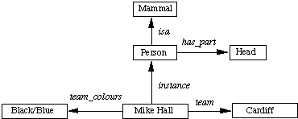
Representation in a Semantic Net The physical attributes of a person can be represented as in Fig.
Fig: A Semantic Network
These values can also be represented in logic as: isa(person, mammal), instance(Mike-Hall, person) team(Mike-Hall, Cardiff)

Slide 36
Frames
A frame is a collection of attributes or slots and associated values that describe some real world entity.
Frames can also be regarded as an extension to Semantic nets. As tasks became more complex the representation needs to be more structured. The more structured the system it becomes more beneficial to use frames.
Each frame represents:
a class (set), or
an instance (an element of a class).

Slide 37
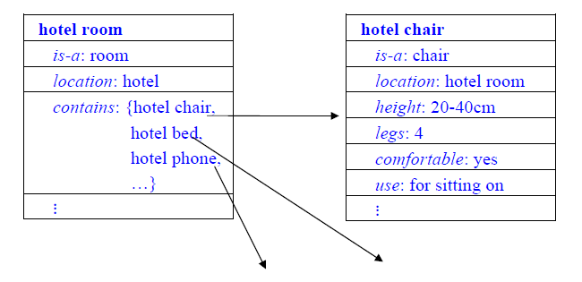
Frame Knowledge Representation

Slide 38
RDF (Resource Description Framework)
RDF is a graph data model that
Formally describes the semantics, or meaning, of information
Represents metadata, i.e., data about data

Slide 39
RDF (Resource Description Framework)
RDF data model consist of triples
Which are based on an Entity-Attributes-Value (EAV) model
Where the structure of each triple is Subject (Entity), Predicate (attribute), Object (value)
Where each triple has a unique identifier, the Uniform Resource Idetifier (URI)
That represents links in an RDF graph

Slide 40

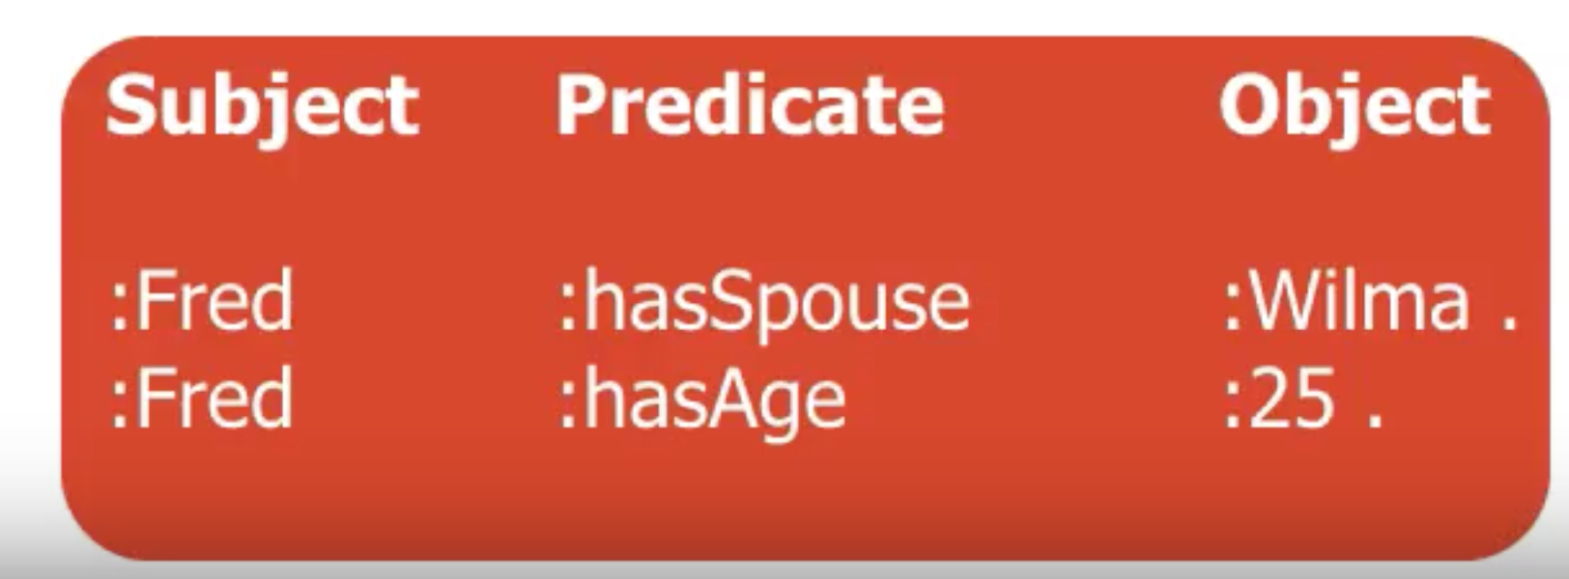
RDF (Resource Description Framework)

Slide 41
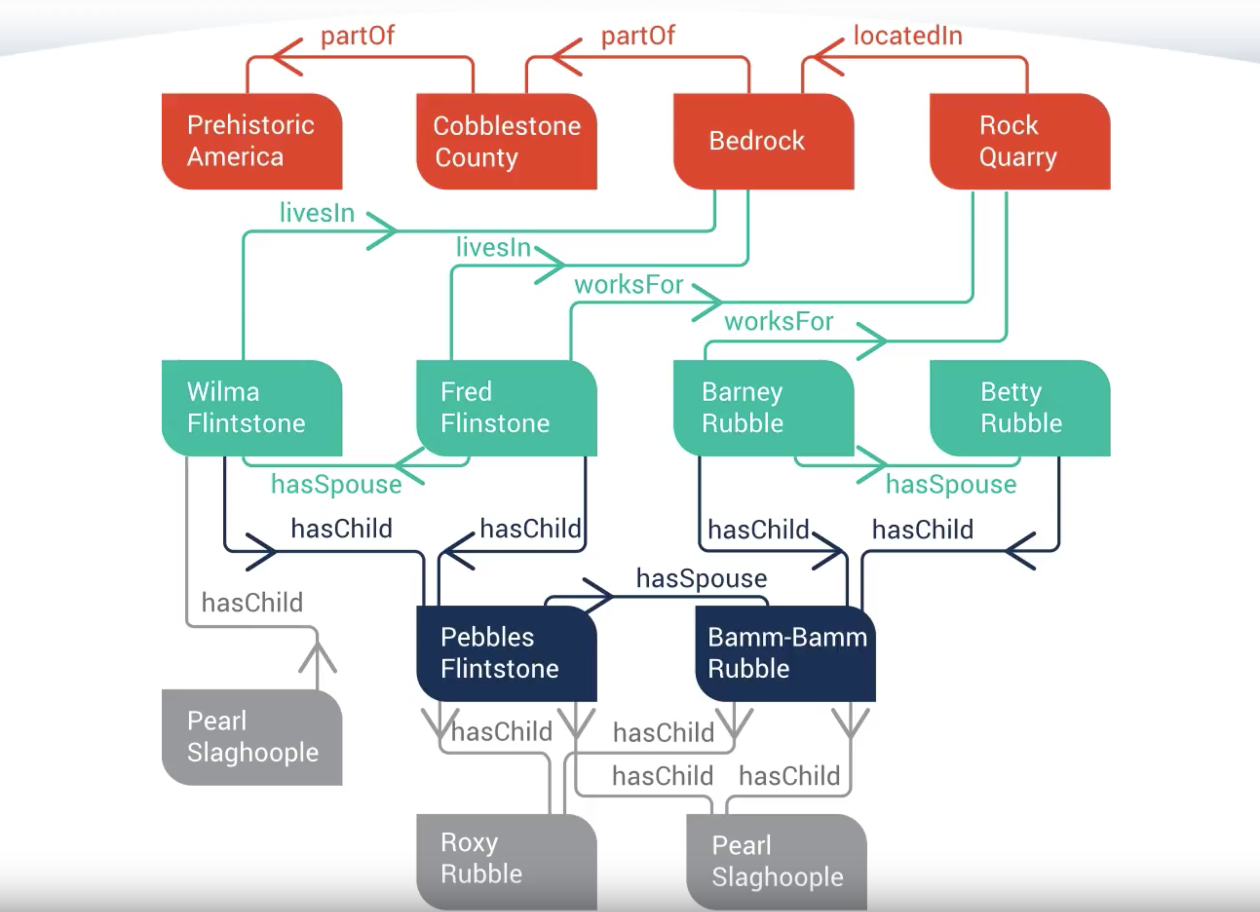

Slide 42
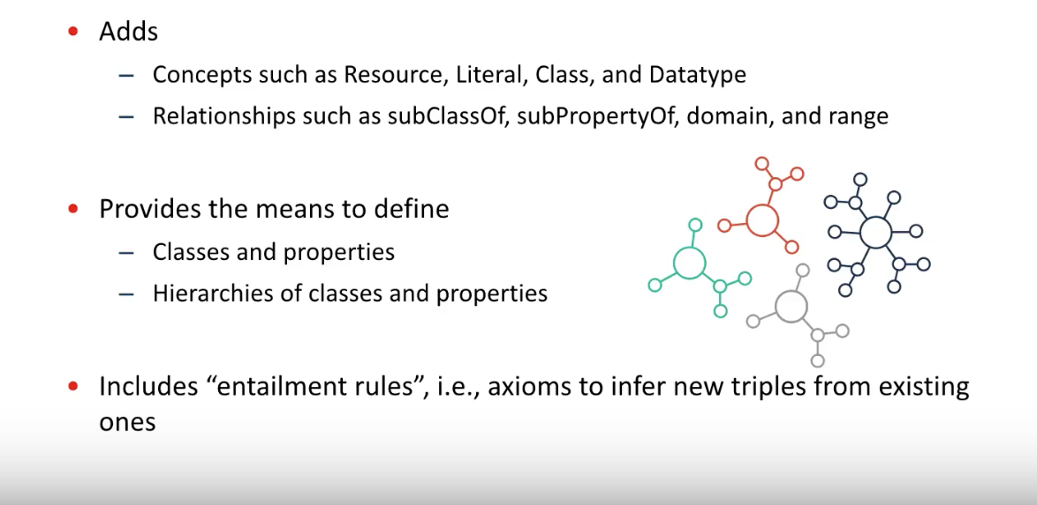
RDF Schema (RDFS)

Slide 43
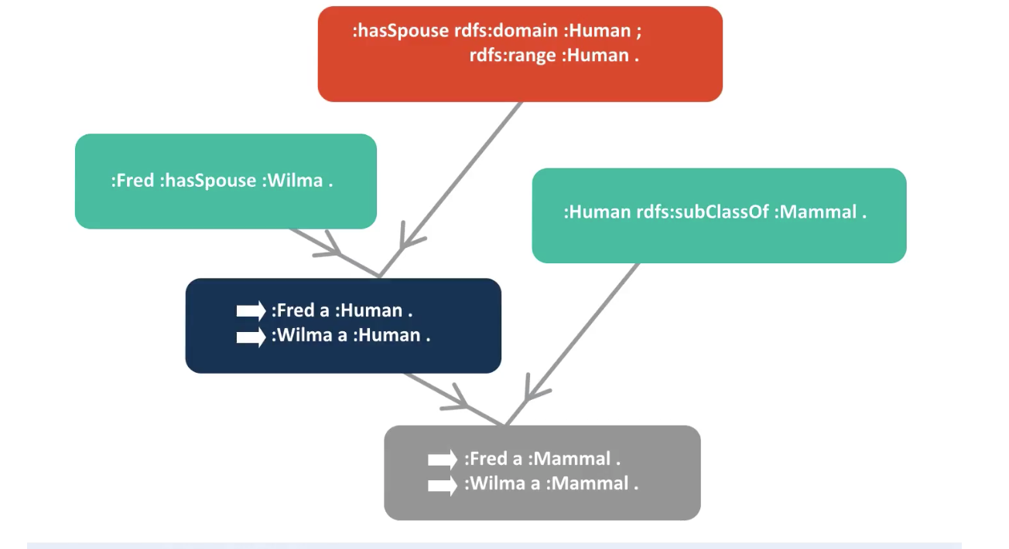

Slide 44
Knowledge Representation

